Slide 1

TITLE:
Giveaway Management System
By
Anurag Sharma(12203267)
Chaitanya()
Javed Khan()

Slide 2
TITLE:
Giveaway Management System
By
Anurag Sharma(12203267)
Chaitanya()
Javed Khan()

Slide 3
Functional requirements:
The ability to create and manage giveaways.
The ability to track entries and winners.
The ability to export data.

Slide 4
Module1:
Shows output as user can enter from 1-4 as given and user can register themselves in the event.
Non-functional requirements:
Security: The system should be secure and protect user data.
Performance: The system should be able to handle a large number of entries without slowing down.
Usability: The system should be easy to use and navigate.

Slide 5
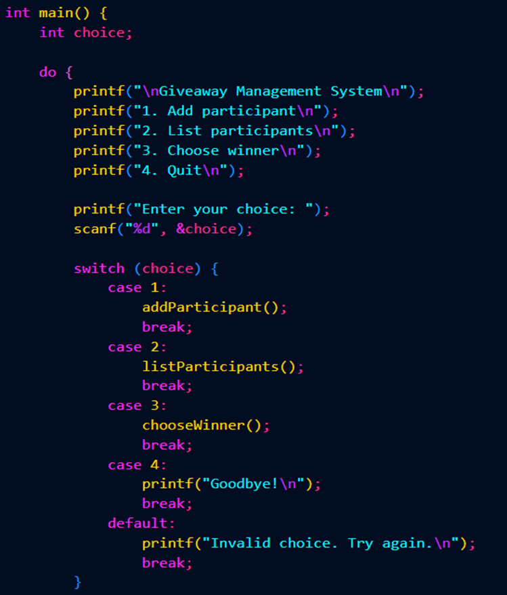
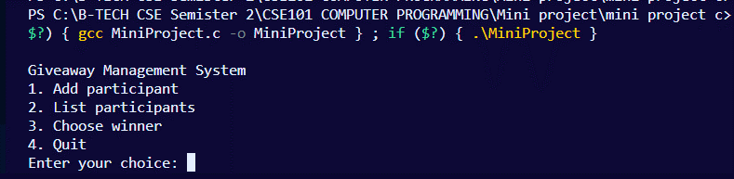
Module1:
Shows output as user can enter from 1-4 as given and user can register themselves in the event.

Slide 6
Module 2:
In the second module audience can enter their credientials to enter the giveaway and it also list the participants.
Module1:
Shows output as user can enter from 1-4 as given and user can register themselves in the event.
Output

Slide 7
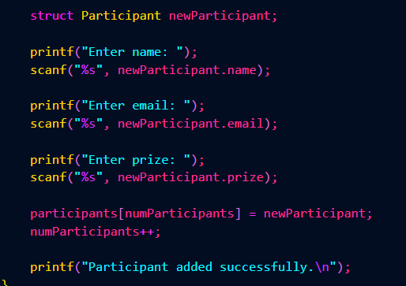
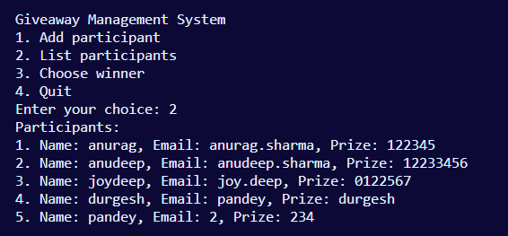
Module 2:
In the second module audience can enter their credientials to enter the giveaway and it also list the participants.
Module1:
Shows output as user can enter from 1-4 as given and user can register themselves in the event.

Slide 8
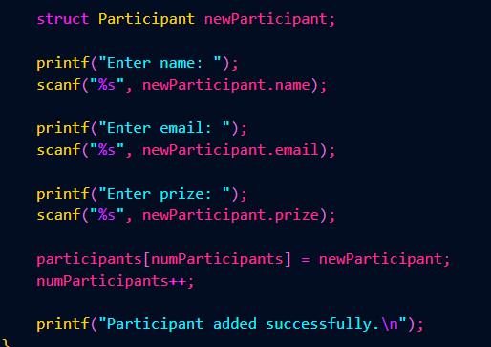
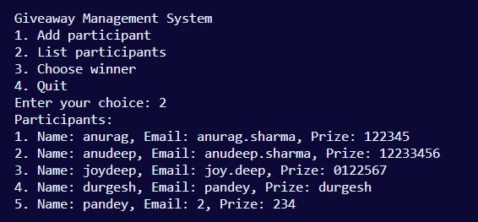
Module 3:
In the third module we have the winner selection randomly from the list participants.
Module 2:
In the second module audience can enter their credientials to enter the giveaway and it also list the participants.
Output

Slide 9
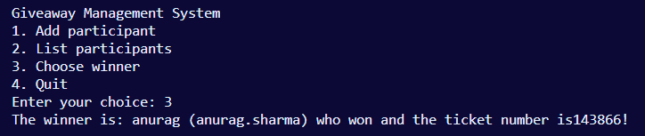
Module 3:
In the third module we have the winner selection randomly from the list participants.
Module 2:
In the second module audience can enter their credientials to enter the giveaway and it also list the participants.

Slide 10

Module 4:
In the fourth module we exit from the code by pressing 4.
Module 3:
In the third module we have the winner selection randomly from the list participants.
Output

Slide 11
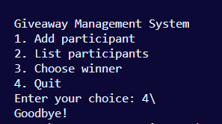
Module 4:
In the fourth module we exit from the code by pressing 4.
Module 3:
In the third module we have the winner selection randomly from the list participants.

Slide 12
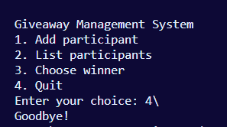
Module 4:
In the fourth module we exit from the code by pressing 4.

Slide 13





Slide 14



Slide 15


